Slide 1

Objectives
In this session, you will learn to:
    Identify the fundamentals of Entity Framework
    Work with Entity Framework

Slide 2
Introduction to Entity Framework (Contd.)
In a database, data is stored in the form of tables and views.
However, in applications data is stored in objects, which have a different structure than tables and views.
Therefore, to retrieve the data stored in tables and views, the definition of classes and objects need to be mapped with that of the relational objects.
This requires you to write complex code.
To overcome this problem, .NET provides the Object-Relational Mapping (ORM) framework called Entity Framework.

Slide 3
Introduction to Entity Framework (Contd.)
Entity Framework enables you to work with relational data in the form of objects by representing the relational objects in the form of a conceptual model in the application.
The conceptual model represents data as entities and relationships among these entities.
In an Entity Framework-based application, the conceptual model is referred to as Entity Data Model (EDM).
EDM allows you to work with data as entities or objects.

Slide 4




Introduction to Entity Framework (Contd.)
Entity Framework uses different approaches to manage data related to an application.
These approaches are:
The database-first approach
The model-first approach
The code-first approach

Slide 5
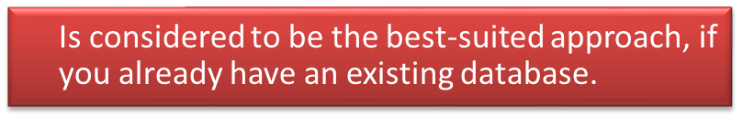



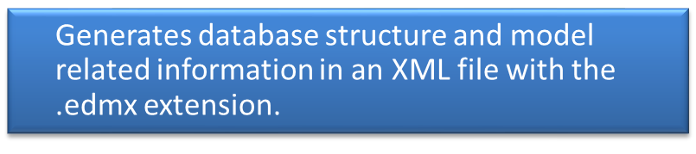
The Database-first Approach
Database-first approach
Creates classes and properties corresponding to the existing database objects in the model.

Slide 6
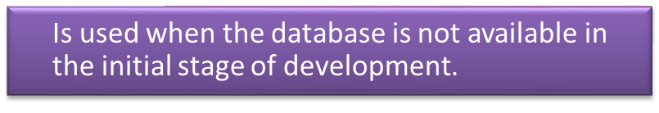



The Model-first Approach
Model-first approach
Allows you to view the different possibilities of improving database structure.

Slide 7
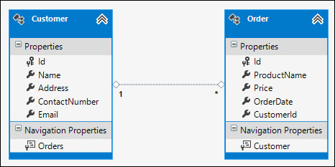
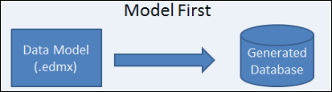
The Model-first Approach (Contd.)
While using the model-first approach, the resulting model and mapping information are stored in the .edmx file.
The following figure displays a model created by using the Entity Framework designer.
The Entity Framework designer uses the .edmx file of the model to create the database, as depicted by the following figure.

Slide 8





The Code-first Approach
Code-first approach
Allows you to first create your own custom classes, and then the database is created from them automatically.

Slide 9
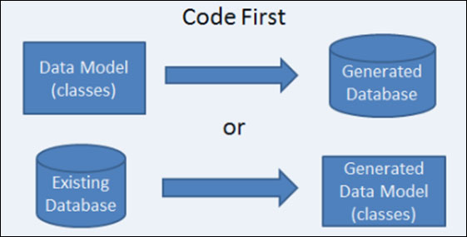
The Code-first Approach (Contd.)
If you have an existing database, you can still define classes that map to the existing database.
In addition, reverse engineering tools are available that allow you to generate the model classes from the existing database.
The following figure represents the code-first approach.

Slide 10
Just a Minute
Which one of the following models uses the .edmx file and generates a database from it?
    Database-first approach
    Model-first approach
    Code-first approach

Slide 11
Just a Minute (Contd.)
Solution:
    Model-first approach

Slide 12







Working with Entity Framework
In the code-first approach:
The structure of the database is determined by examining the structure of the model.

Slide 13


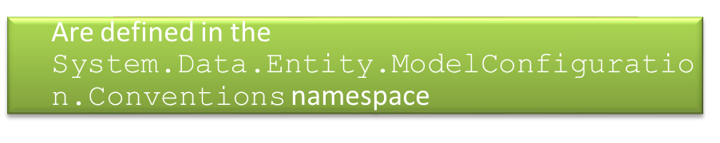

Code First Conventions
Code first conventions
Consists of the following conventions:
Table naming convention
Primary key convention
Relationship convention

Slide 14
Code First Conventions (Contd.)
Based on table naming convention, if the name of the model class is "Customer", the name of the corresponding table will be "Customers“.
Based on primary key convention:
    If in a class, you have created the property named ID or <classname>ID, the property is assumed to be a primary key.
    Entity Framework sets up an auto-incrementing key column in SQL Server to hold the property value.

Slide 15
Code First Conventions (Contd.)
Based on relationship convention:
    A relationship between two entities can be defined by using navigational properties.
    It is recommended to define a foreign key property on types that represent dependent objects.
    Entity Framework uses certain conventions to identify a foreign key.
    Entity Framework infers that a property is a foreign key, if it meets the following conditions:
      The property has the same data type as the principal primary key.
      The name of the property follows any one of the following formats:
        <navigational property name><principal primary key property name>
        <principal class name><principal primary key property name>
        <principal primary key property name>

Slide 16




Using the Code-first Approach
You can use the code-first approach by performing the following steps:
Create the model classes.
Create the database context.
Configure the database location.
Create a controller.

Slide 17
Using the Code-first Approach (Contd.)
Creating the model classes:
    You can create a model by simply using C# classes.
    Example:
public class Customer{
public int ID { get; set; }
public string Name { get; set; }
public string Gender { get; set; }
public string Address { get; set; }
public string Email { get; set; }
}
public class Product{
public int ID { get; set; }
public string Name { get; set; }
public string Description { get; set; }
}

Slide 18
Using the Code-first Approach (Contd.)
Creating the database context:
    The database context class:
      Coordinates with Entity Framework and allows you to query and save the data in the database.
      Can be defined by deriving from the System.Data.Entity.DbContext class.
      Exposes one or more properties of the type, DbSet <T>, where T represents the type of object that needs to be stored in the database.
    Example:
public class ShopDataContext : DbContext
{
public DbSet<Customer> Customers { get; set; }
public DbSet<Product> Products { get; set; }
}

Slide 19






Using the Code-first Approach (Contd.)
Configuring the database location:
    Entity Framework automatically creates the database in SQL Server with the name of the database context.
    It is advisable to configure the database location to keep track of the database that is being used.
    To configure the database location, you need to define a connection string in the Web.config file.
    The connection string can have various connection string properties. Some of the important connection string properties are:
Data Source
Initial Catalog
Integrated Security
Persist Security Info
AttachDBFilename
providerName

Slide 20
Using the Code-first Approach (Contd.)
    HTTP POST version:
      [HttpPost]
    public ActionResult Create(Customer customer)
    {
    if (ModelState.IsValid)
    {
    db.Customers.Add(customer);
    db.SaveChanges();
    return RedirectToAction("Index");
    }
    return View(customer);
    }

Slide 21
Using the Code-first Approach (Contd.)
The Edit() action method:
    Handles the operation of editing the data related to a particular model object.
    Is created in two versions, where:
      One of the Edit() action methods finds the data related to a model object whose records need to be edited and renders the Edit view, as shown in the following code snippet:
public ActionResult Edit(int id = 0)
{
Customer customer = db.Customers.Find(id);
if (customer == null)
{
return HttpNotFound();
}
return View(customer);
}

Slide 22
Using the Code-first Approach (Contd.)
      The other Edit action method is invoked whenever the HTTP POST request is received from the Edit view.
      This action method first validates the data entered by the user, and then saves the updated data.
      Example:
[HttpPost]
public ActionResult Edit(Customer customer)
{
if (ModelState.IsValid)
{
db.Entry(customer).State = EntityState.Modified;
db.SaveChanges();
return RedirectToAction("Index");
}
return View(customer);
}

Slide 23
Using the Code-first Approach (Contd.)
The Details() action method:
    Contains the code to find the details related to a particular model object.
    Finds the records on the basis of the parameter value passed to it, which is the primary key, such as id.
  Example:
public ActionResult Details(int id = 0)
{
Customer customer = db.Customers.Find(id);
if (customer == null)
{
return HttpNotFound();
}
return View(customer);
}

Slide 24
Using the Code-first Approach (Contd.)
The Delete() action method:
    Handles the operation of deleting the data related to a particular model object.
    Created in two versions, one for the HTTP GET request and the other for the HTTP POST request.
  The HTTP GET version of the Delete() action method finds the data related to a model object whose record needs to be deleted and renders a view.
  Example:
public ActionResult Delete(int id = 0)
{
Customer customer = db.Customers.Find(id);
if (customer == null)
{
return HttpNotFound();
}
return View(customer);
}

Slide 25
Using the Code-first Approach (Contd.)
      The HTTP Post version of the Delete() action method is named as DeleteConfirmed().
      The DeleteConfirmed() method deletes the required record, and then saves the changes in the database.
  Example:
[HttpPost, ActionName("Delete")]
public ActionResult DeleteConfirmed(int id)
{
Customer customer = db.Customers.Find(id);
db.Customers.Remove(customer);
db.SaveChanges();
return RedirectToAction("Index");
}
Let us see how to create a controller by using scaffolding

Slide 26
Demo: Working with the EF Code-first Approach
Problem Statement:
    As a member of the development team at GlobalIT, you have developed a Web application for Rainbow Entertainment, which consists of the following pages:
      Home: This page lists the currently showing movies.
      Upcoming movies: This page lists the name and star cast of the movies to be launched.
      About Us: This page displays a brief description about the company.
      Contact Us: This page displays the details using which a user can contact Rainbow Entertainment.
    Now, you have been assigned a task to create pages that allow the administrator of Rainbow Entertainment to add, edit, and delete movie details. In addition, you have to create a Web page that displays a list of added movies.

Slide 27
Summary
In this session, you learned that:
    Entity Framework enables you to work with relational data in the form of objects by representing the relational objects, such as tables, views, stored procedures, and functions, in the form of a conceptual model in the application.
    While developing an application, if you already have an existing database, the database-first approach is considered to be the best-suited approach.
    In the model-first approach, the first priority is the model, while the code and the database are secondary.
    In the code-first approach, you can start the development of your application by coding custom classes and properties, which correspond to tables and columns in the relational database.
    A relationship between two entities can be defined by using navigational properties.

Slide 28
Summary (Contd.)
    You can use the code-first approach by performing the following steps:
      Create the model classes.
      Create the database context.
      Configure the database location.
      Create a controller.
    A connection string specifies information about a data source and the way to establish a connection.

